Slide 1
xAI in Text Classification
Vlad Mihai Olaeriu

Slide 2
Introduction
Are attentions reliable explanations? What is the influence of xAI in NLP?
Recent research questions the reliability and stability of attention as an explanation method
Critical for hate speech detection, depression classification or any other clinical/monitoring text application
Aim is to compare attention with the LIME and SHAP saliency methods on hate speech classification

Slide 3
Related Work
Jain & Wallace (2019) showed that attention weights show weak or zero correlation with gradient based methods; moreover, they showed that you can construct adversarial attention distribution that yield identical predictions.
Bastings & Filippova (2020) stated that attention only captures single computation point, missing full information flow and they recommended saliency methods for identifying important tokens.

Slide 4
Dataset - UC Berkeley Hate Speech
39,565 comments
7,192 annotators
Hate speech score for each comment: >=0.5 hate speech, <=-1 supportive speech and the interval inside neutral / ambiguous
Eight identity groups: race, religion, gender, origin, age, sexuality, disability, and politics

Slide 5
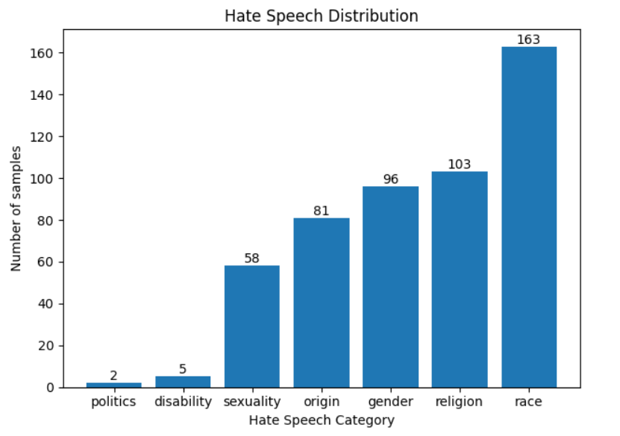
Dataset - UC Berkeley Hate Speech

Slide 6
Model
facebook/roberta-hate-speech-dynabench-r4-target
4 rounds of human-and-model-in-the-loop training
12 heads
12 layers

Slide 7

Method - Explanation Features
Attention Scores were computed using the last L = 4 layers of the RoBERTa model with all of its H = 12 attention heads. The query token targeted was the [CLS] one, and the key was represented by each of the other tokens.

Slide 8
Method - Explanation Features
Lime Scores were generated using a total of N = 1000 perturbed samples by the surrogate classifier, and the tokenization method used was the default one provided by the lime module.

Slide 9
Method - Explanation Features
SHAP scores were computed using the model’s tokenizer, which provided the possibility to compare them to the attention scores, to see how well they correlate. Each token was masked, and the behavior of the model without the masked token yielded this score.

Slide 10
Method - Explanation Features
Evaluation: after the computation of scores, they were normalized using softmax, and for each sample, the following metrics were computed: entropy, Gini and top-5 mass token concentration.
These metrics were then averaged together by hate speech category.
Ranking: the correlation attention and SHAP scores was assessed using: Spearman, Kendall Tau for all tokens and Jaccard for the top-5 highest scoring tokens.

Slide 11


Method - Adversarial Examples
For each sample, the top-5 highest scoring tokens were replaced with semantically similar synonyms using wordnet, and the attention, LIME and SHAP scores were recomputed for the adversarial examples.
Evaluation per hate speech category:
flip rate (FR): how many predictions changed from hate speech to non hate speech
confidence distribution (CD): how much the hate speech prediction changed, mean and standard deviation for this distribution

Slide 12
Results - Explanation Features
Category | Entropy | Gini | Top-5 Mass
Gender | 0.9874 | 0.0922 | 0.4490
Origin | 0.9885 | 0.0936 | 0.3581
Race | 0.9891 | 0.0851 | 0.4068
Religion | 0.9884 | 0.0850 | 0.3625
Sexuality | 0.9926 | 0.0786 | 0.6108
Distribution Metrics for Attention Weights

Slide 13
Results - Explanation Features
Category | Entropy | Gini | Top-5 Mass
Gender | 0.9936 | 0.0636 | 0.5131
Origin | 0.9961 | 0.0565 | 0.4223
Race | 0.9945 | 0.0575 | 0.5068
Religion | 0.9939 | 0.0617 | 0.4575
Sexuality | 0.9900 | 0.0671 | 0.7538
Distribution Metrics for LIME scores

Slide 14
Results - Explanation Features
Category | Entropy | Gini | Top-5 Mass
Gender | 0.9449 | 0.2181 | 0.5193
Origin | 0.9643 | 0.1820 | 0.4036
Race | 0.9583 | 0.1945 | 0.4659
Religion | 0.9569 | 0.1922 | 0.4169
Sexuality | 0.9348 | 0.2284 | 0.6840
Distribution Metrics for SHAP scores

Slide 15
Results - Explanation Features
Category | Spearman | Kendall Tau | Jaccard Top-5
Gender | 0.0331 | 0.0232 | 0.0859
Origin | 0.0477 | 0.0388 | 0.0753
Race | 0.0152 | 0.0075 | 0.0947
Religion | 0.0148 | 0.0103 | 0.0810
Sexuality | -0.1779 | -0.1574 | 0.1784
Ranking Metrics for Attention Weights-SHAP

Slide 16
Results - Adversarial Examples
Category | FR | CD-µ | CD-σ
Gender | 1.04% | -0.0785 | 0.2790
Origin | 7.41% | -0.0404 | 0.3505
Race | 3.68% | -0.0693 | 0.3023
Religion | 6.86% | 0.0102 | 0.3457
Sexuality | 5.17% | 0.0027 | 0.3110
Adversarial Metrics for Attention Weights

Slide 17
Results - Adversarial Examples
Category | FR | CD-µ | CD-σ
Gender | 2.08% | -0.0585 | 0.2894
Origin | 9.88% | -0.0216 | 0.3627
Race | 2.45% | -0.0498 | 0.2749
Religion | 4.90% | 0.0239 | 0.2416
Sexuality | 3.45% | 0.0160 | 0.2179
Adversarial Metrics for LIME

Slide 18
Results - Adversarial Examples
Category | FR | CD-µ | CD-σ
Gender | 9.38% | -0.0638 | 0.3018
Origin | 12.35% | -0.0222 | 0.3673
Race | 6.13% | -0.0537 | 0.2799
Religion | 6.86% | 0.0253 | 0.2451
Sexuality | 6.90% | 0.0166 | 0.2218
Adversarial Metrics for SHAP

Slide 19
Conclusion
attention weights alone are unreliable: weak correlation with SHAP shows they capture different aspects of model behavior
SHAP identifies more critical tokens: higher flip rates in adversarial tests indicate SHAP-identified tokens have stronger influence on predictions
Multiple explanation methods are necessary

Slide 20
Thank you!

